Slide 1
Week Two – Using GitHub in teams
By Aaron Ward

Slide 2
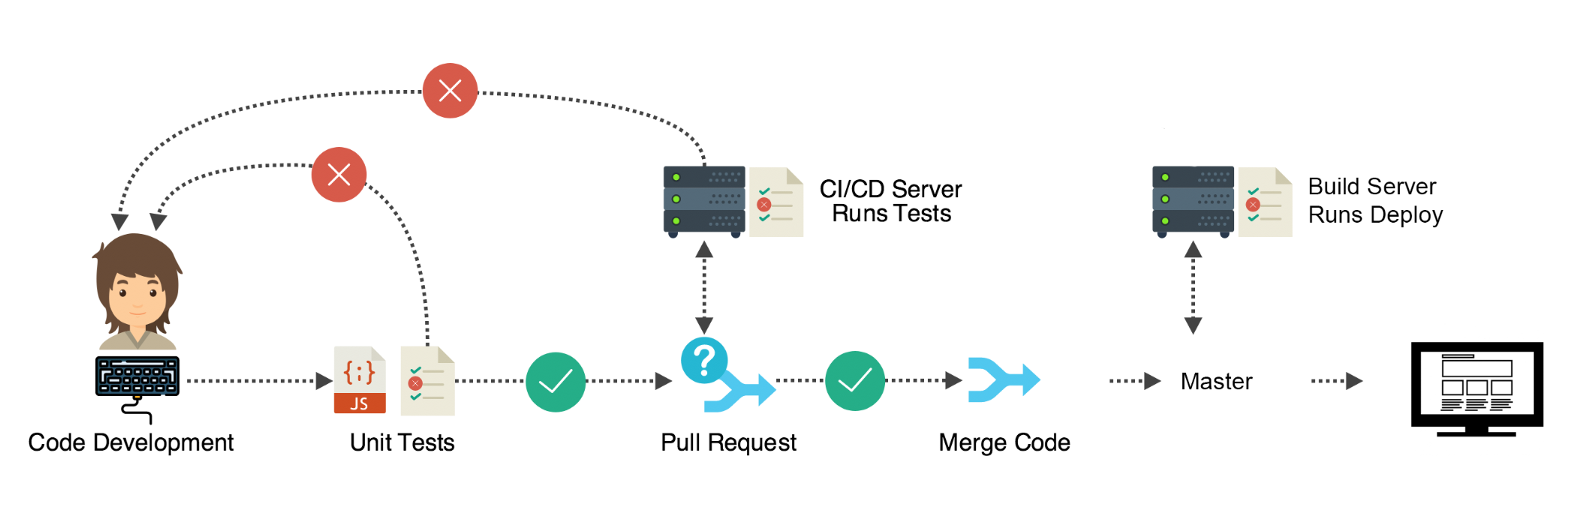
Using github in teams
We are going to go over:
Quick intro to GitHub and Git
Basic commands
Working with pull requests
Conventions + tips
Common mess ups

Slide 3
Introductions
What is Git?
Git is a version control system used for tracking changes in repositories of code
Why? Because humans are dumb and we make mistakes (IE: delete an entire college project the day before its due 🙂)
Also we may want to revert back to older versions of code
What is GitHub?
GitHub is used for hosting repositories
It also allows your to track progress, fork other peoples code, create organizations, do code reviews and manage projects.

Slide 4
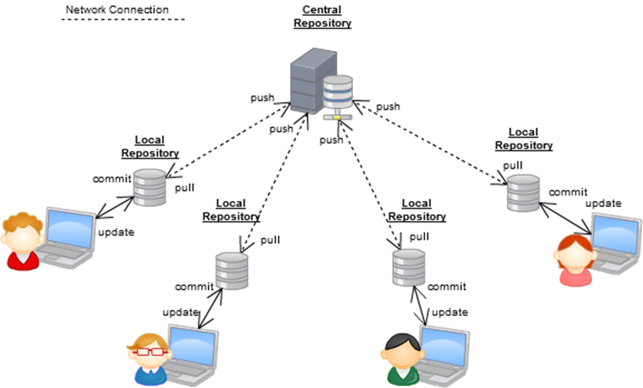

Slide 5
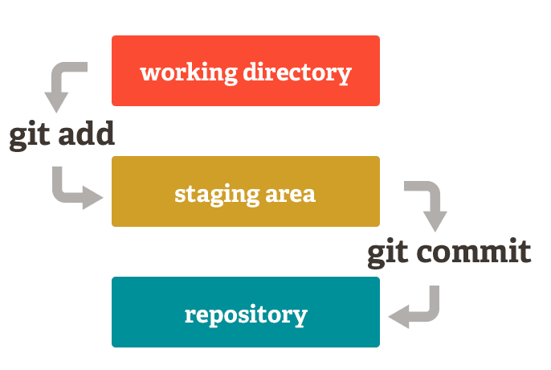
How it works
create a repo on github
clone that repo to your local machine
Make some code change in your working directory
This code changes are untracked. But now you want to push that code to Github for other team members to see, ok now what?
Lets take about staging
The staging area is the place where git starts tracking your files.
You need to tell git “hey add this to the staging area please ☺ “
When, you have added all the files you want tracked you can do a commit command, which is like saving progress.
You can check to see if files are tracked using git status command.

Slide 6
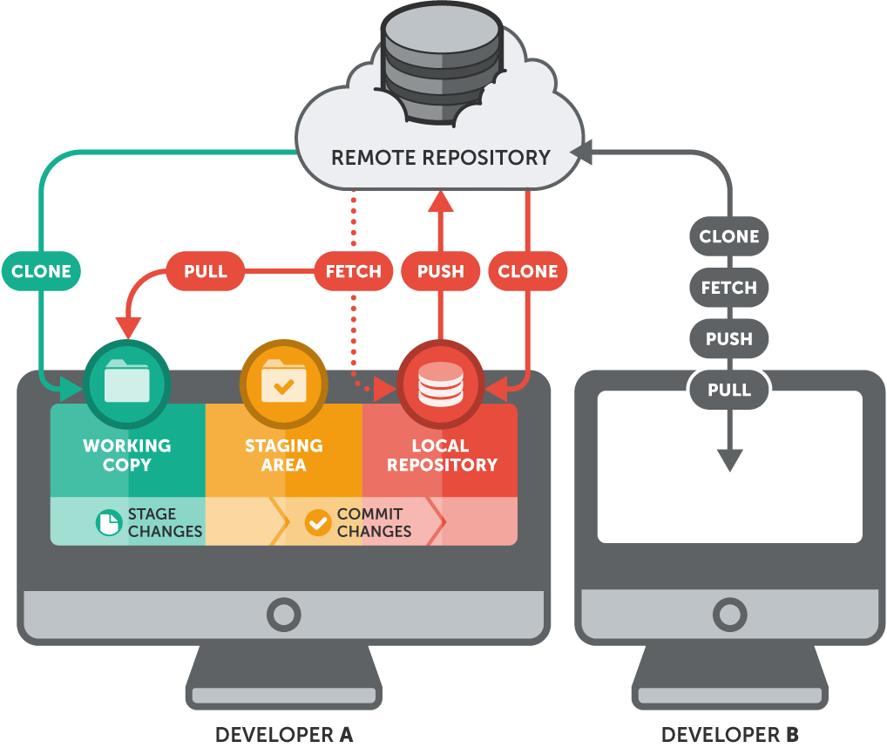
Next steps
Okay, so you’ve committed your files, what now?
You need to “upload” that code to GitHub.
This is done using the push command.
You push to what ever branch you are working on.
We will talk about branches shortly.

Slide 7
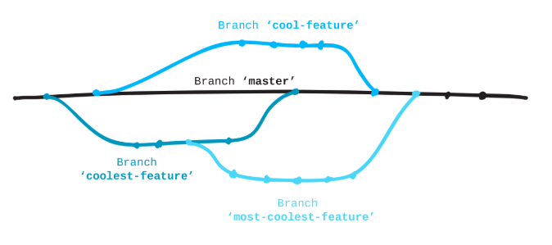
What are branches?
A branch is a term for an another version of the code base that can be worked on in isolation, until its ready to be merged with the main codebase.
A branch is usually created when you want to test out a new feature in your software
Branches are a core concept with Git – you can test out new ideas and break whatever you want with affecting the “master” branch
Branches in your repo should look like this:
Master – deployable code
Develop – teams working progress
Feature_one – team members working progress
You get the idea
RULE OF THUMB: whatever is in your master branch should always be fully functioning and deployable - never push buggy or broken features to master

Slide 8
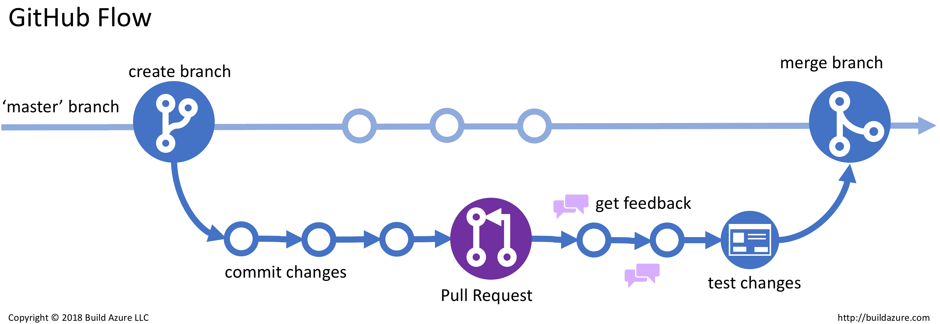
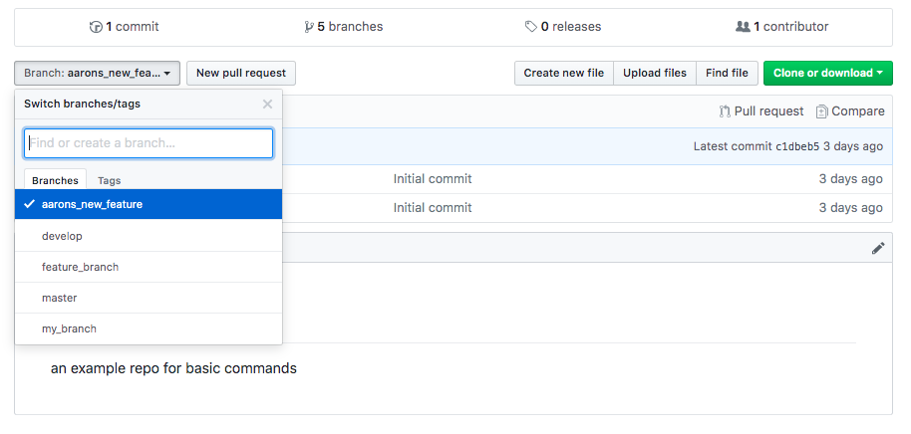

Slide 9
Basic Commands
Add files to staging area
Git add <file name>
Do a “save” – also known as a commit
Git commit –m “some comment about the change”
Push the code to the remote branch
git push origin feature_branch
Clone a repo from GitHub to your local machine
Git clone https://github.optum.com/tdp-example-org/example-repo.git
Work from a feature branch
Git fetch
Git checkout --track origin/feature_branch
Check what files are being tracked
Git status

Slide 10
Flow of development – from start to finish
Make code changes in your local repo on a feature branch
Stage, commit and push to your remote feature branch
Submit a pull request on GitHub (more on this later)
Get the code reviewed – make sure it doesn’t break anything in your develop branch
The reviewer should merge your code from feature_branch to develop
Merging from Develop to master should only ever happen when the code has been tested, reviewed and new version is scheduled to be released.

Slide 11
Working with Pull requests
When you want code to be reviewed and merged to the develop branch you have to make a pull request
PR’s are a vital part of software engineering and should always be done.
When a PR is accepted, it merges the code to the specified branch, and can be closed.
Ill show you how to do this.
Why are pull request important?
You can go without using them, but this is really bad software engineering practice
Lets say you own an open source project and you want people to contribute
You don’t want anyone pushing their rubbish code to your master branch
The same should apply in in projects

Slide 12
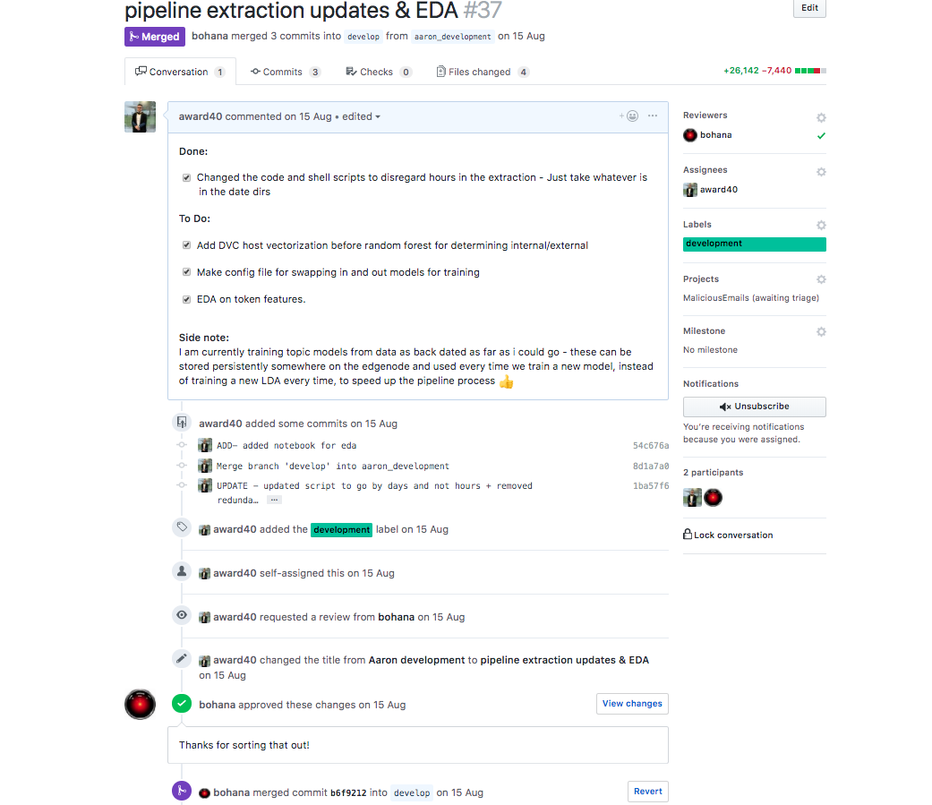

Slide 13
Updating you local repo
Pulling code from develop to your local branch
Lets say your team mate gets PR accepted on the feature_one branch, and their code is merged to develop – How do you update your local branch called my_branch?
If a local develop branch doesn’t exist, then make one
Git checkout develop
git branch --set-upstream-to=origin/develop develop
Git pull
Git checkout my_branch
Git merge develop
In a nutshell, this pull the new code in local develop, you switched to the branch your working on – then you merged the new code in to your branch. BOOM, it’s that easy!

Slide 14
Merge Conflicts
Your team mate broke your code, what now?
This happens when two people change the same line of code and you are both “competing” for a commit. You should:
Identify where the conflict Is in the file
Keep the code that that you want, and delete the line creating the merge conflict.
Git add, commit and push again
Merge conflicts should never be commited to remote branchs – keep the problems to your local machine.

Slide 15
Conventions and Tips
Informative commit comments
Git commit –m “ADD – added new function to perform regexes on label column
Git commit –m “UPDATE – updated code to get 2 different regular expressions”
Git commit –m “FIX – fix function that printed accidentally printed credit card details 😕“
Git commit –m “<name of the user story you are working on>”
Never use “git add . “
This will add everything
You will cause yourself a world of pain when you add the wrong files or a large file by accident
Ask someone to do a code review before assigning them on GitHub – just a nice thing to do ☺

Slide 16
.gitignore files
These can be a saving grace
Make sure to use them in your repository
Protip: you can autogenerate a .gitignore for the language you are using on GitHub.
Version control your code, not your data
Cannot stress this enough, your data or binary files should never live on repo
A serious no-no!
Testing data is the exception to this
Remove Github password from your keychain on your mac
When you change your password after 90 days, the old one is cached on your keychain
Go to finder, enter “Keychain Access” and delete ”github.optum.com”
Always refresh your branches
You don’t want your branch going stale and falling too far behind develop and master

Slide 17
Common mess-ups (and how to fix them)
If you did decide to ignore my advice and did these things anyways, here are some ways to fix them 🙃
Unstage huge files
Lets say you used git add . and it added a 200MB file to your staging area
git reset –soft HEAD~1 - to unstage the last commit
Lets now lets say you accidentally tracked a folder
git rm --cached –r <directory name>

Slide 18
Useful Resources
What is github: https://www.youtube.com/watch?v=w3jLJU7DT5E
Siraj Raval – How to use github: https://www.youtube.com/watch?v=Loav1kbA640
Stashing – https://git-scm.com/book/en/v1/Git-Tools-Stashing

